Slide 1

GOKARAJU RANGARAJU INSTITUTE OF ENGINEERING & TECHNOLOGY (AUTONOMOUS) Department Of Electronics and Communication Engineering DESIGNING A MAC UNIT USING APPROXIMATE MULTILPLIER
Review-3
Under the Guidance of Batch No. -A12
Dr. K Jamal K.Prathyusha- 20241A0431
M.Balaraju-20241A0436
B.Akash-20241A0405

Slide 2
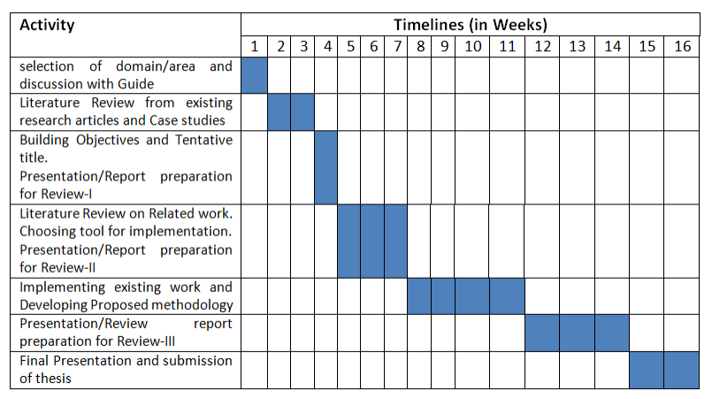
PLAN OF ACTION

Slide 3
CONTENTS
ABSTRACT
INTRODUCTION
PROBLEM STATEMENT
PROJECT OBJECTIVES
EXISTING APPROACH
PROPOSED METHODOLOGY
CONCLUSION & FUTURE SCOPE
REFERENCES

Slide 4
ABSTRACT
In numerous applications, multipliers play a crucial role as arithmetic functional units, often requiring extensive multiplications that contribute significantly to power consumption. Employing an approximate multiplier represents a novel strategy to reduce critical path time and power usage in error-tolerant systems. The trade-off involves sacrificing accuracy for enhanced performance and reduced energy consumption. To cater to varying precision requirements, this article not only introduces a highly accurate approximate 4-2 compressor but also proposes a adaptable approximation multiplier capable of dynamically truncating partial products. Additionally, a Multiplier and Accumulation (MAC) unit is recommended. Depending on user needs, the suggested MAC unit, paired with an approximate multiplier, can dynamically adjust power and accuracy for multiplications during runtime.

Slide 5
INTRODUCTION
Multipliers are among the most critical arithmetic functional units in many applications, such as digital signal processing (DSP), computer vision, multimedia processing, image recognition, and artificial intelligence. Those applications commonly need numerous multiplications that result in huge power consumption. The high-power consumption is a challenge for implementing those applications, especially on mobile devices. Therefore, many studies have proposed techniques to reduce the power consumption of multiplier circuits. One solution to reduce the power consumption of a multiplier is to approximate multiplication if the targeted applications allow error tolerance, or in other words, if they are related to human senses.

Slide 6
PROJECT OBJECTIVES
1.Proposing the construction of the recommended approximate multiplier, which is based on a high-precision approximate 4-2 compressor.
2. Presenting a straightforward circuit for error compensation intended to further minimize error lengths.
3.Presenting a dynamic input truncation method that allows for the adjustment of power and precision requirements in multiplication.
4.Developing a Multiply and Accumulate (MAC) unit that incorporates an approximate multiplier in this project.

Slide 7
EXISTING METHODOLOGY
The proposed 4-2 approximate compressor is shown in figure . The design of the proposed approximate 4-2 compressor is described. Four inputs X1 ∼ X4 are used to generate W1 ∼ W4 using Eqs. Because an incorrectly computed carry bit has a higher error distance than the sum bit, i.e., an incorrect carry bit produces two times ED of that produced by an incorrect sum bit, the carry bit in the proposed compressor is designed always to be correctly generated. The equations of generating carry bit . The carry bit will become 1 under three circumstances. One is X1 and X2 are both 1. Gate-level implementation of proposed 4-2 compressor. Another is X3 and X4 are both 1. The third is either of X1 or X2 is 1 and either of X3 or X4 is 1. checks the first two situations, and checks third situation. produces the final carry bit.
W1 = X1 AND X2
W2 = X1 OR X2
W3 = X3 AND X4
W4 = X3 OR X4
W5 = W1 OR W3
W6 = W2 AND W4
Carry = W5 OR W6

Slide 8
PROPOSED METHODOLOGY
The proposed equation to generate the sum bit is shown in below .In an accurate 4-2 compressor, the sum bit is generated with four XOR gates built within the two full adders. Whereas in our proposed compressor, we generate the sum bit by inputting W2 and W4 into a 2-input XOR gate to utilize the signals that are used to generate the carry bit. By sharing to achieve high accuracy, we add W5, the signal used to detect these two cases, into the XOR gate. For example, if both X1 and X2 are 1, both W2 and W5 will be 1, and the sum bit will turn out to be ‘0 XOR W4’, resulting in W4 as the sum bit. In this case, the number of bits that needto be considered are only X3 and X4
Sum = W5 XOR W2 XOR W4
Error = W1 AND W3
For the error detection purpose, we only need an extra AND gate to detect whether both W1 and W3 are 1, because W1 uses an AND gate to detect whether both X1 and X2 are 1, and W3 uses an AND gate to detect whether both X3 and X4 are 1. The equation of the error detection circuit(EDC). Therefore, the error compensation circuit of the proposed 4-2 compressor can be easily constructed by adding an extra AND gate. we propose a dynamic input truncation technique, which uses two 2-input AND gates, as shown in FIGURE 5, to produce a partial product, where A is the multiplicand and B is the multiplier. The Trunc signal is used to determine whether the partial product PPD should be truncated. If the Trunc is 1, the partial product is truncated to 0. To be more precise, the Trunc signals save the power by truncating the PPDs in the multiplications to zeros
PPDij= (∼ Trunc AND Bi) AND Aj

Slide 9
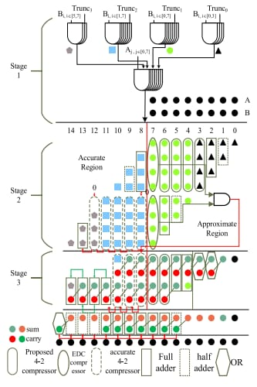
APPROXIMATE MULTIPLIER METHODOLOGY

Slide 10
In the first stage, each partial product is generated by two 2-input AND gates with the gate sharing technique applied in to further reduce hardware costs. Depending on the requirements, the accuracy of the generated partial product can be determined based on the Trunc signal.
The second stage shows the steps of compressing the partial products. After the partial products are generated, they are divided into two regions: column 14th∼8th being the accurate region, and 7th∼0th being the approximate region. The split of accurate and approximate region is decided from the most intuitive half-half separation. Because the weight of the partial products in the accurate region is higher and more important, we compress the partial products in that region with accurate 4-2 compressors. On the other hand, we use our proposed approximate 4-2 compressors and error compensation circuit to compress the partial products in the approximate region.
The third stage, we use OR gates in columns 3rd ∼0th to generate results and ignore carry propagation considering them close to LSB, whose errors have less effect on the final results. We detect errors in t with the EDC, i.e., a single AND gate, to determine whether the compensation bit should he second stage be produced. We use the proposed approximate 4-2 compressors, accurate 4-2 compressors, full adders, and half adders to compress the partial products in the remaining columns. After finishing the third stage, we get the final two partial product rows, which is summed up by using accurate adders to produce the final results.

Slide 11
PROPOSED METHODOLOGY
A MAC unit is a common component found in numerous digital signal processing systems. that use accumulation and multiplication. It also operates digital DSP systems with high speed. DSP is utillized in a variety of procedures, including convolution, filtering, and inner products. DSP techniques often utillize nonlinear functions such as Discrete wavelet transforms (DWT) and Discrete cosine transforms (DCT). The whole speed of the arithmetic computations, which includes addition and multiplication, is established by the speed of execution and the performance of the full calculation since addition and multiplication are efficiently finished by cyclic application of addition and multiplication. Procedures that multiply and aggregate are unique to digital filters.

Slide 12
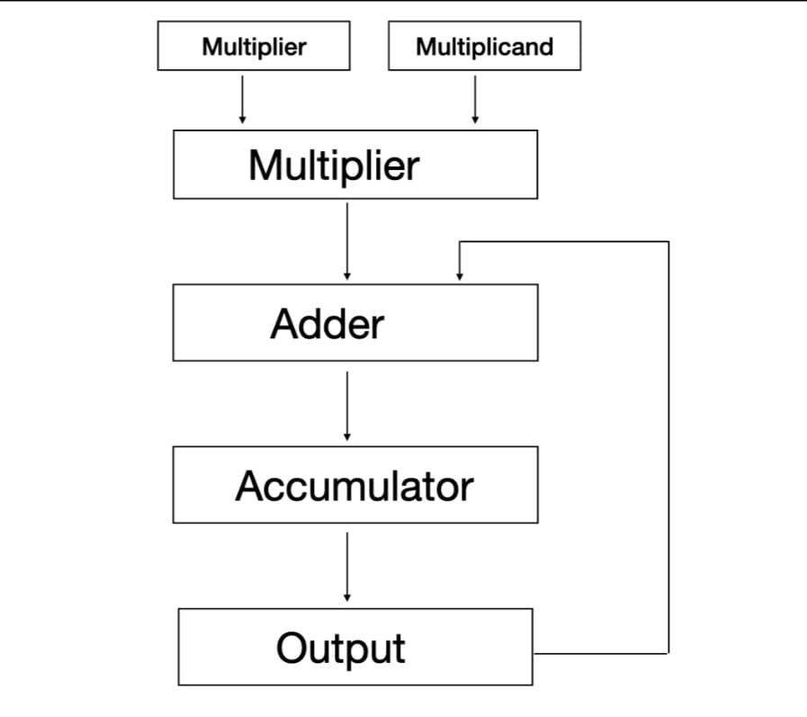
Block Diagram of Mac

Slide 13
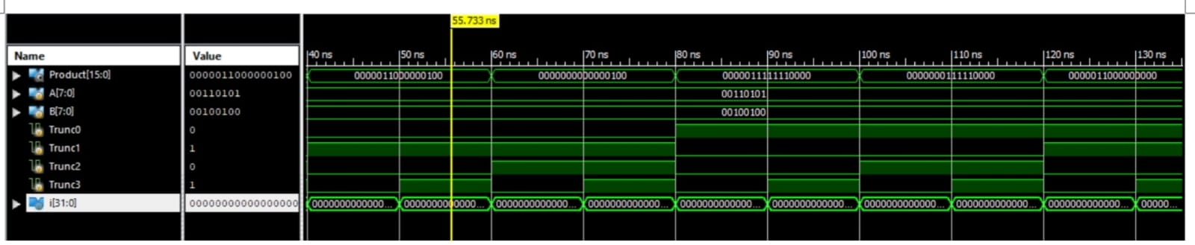
Results
Simulation waveforms of approximate multiplier.

Slide 14
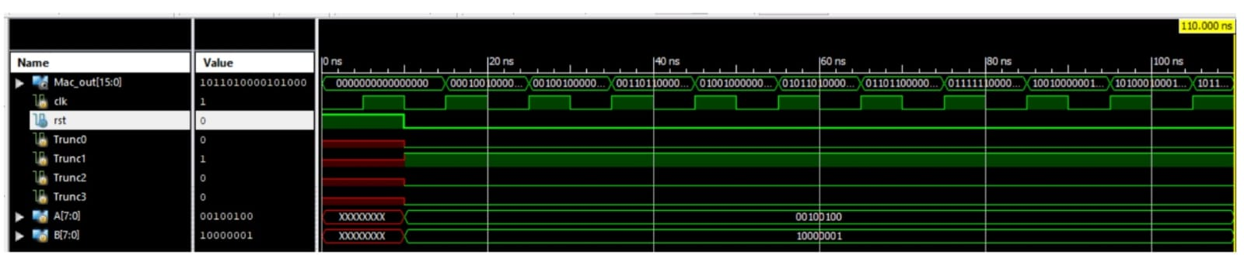
Simulation waveform of Mac.

Slide 15
CONCLUSION & FUTURE SCOPE
This study introduces a new method involving approximate 4:2 compressor designs coupled with an approximate multiplier for constructing MAC (Multiplier-Accumulator) units. The aim is to cater to different precision requirements. We describe an extremely accurate Approximate 4-2 Compressor and suggest a flexible approximation multiplier that may dynamically truncate partial products. Additionally, we propose a MAC unit that can adjust power consumption and accuracy levels for multiplication tasks based on user requirements during runtime.In essence, designing an approximation multiplier with absolute advantage is quite difficult, and the best solution is usually the one that best fits the intended use. We provide a contender with a competitive error-electrical performance tradeoff in our approximate multiplier design.

Slide 16
REFERENCES
[1] B. Moons and M. Verhelst, ‘‘DVAS: Dynamic voltage accuracy scaling for increased energy-efficiency in approximate computing,’’ in Proc. IEEE/ACM Int. Symp. Low Power Electron. Design (ISLPED), Jul. 2015, pp. 237–242.
[2] D. Mohapatra, V. K. Chippa, A. Raghunathan, and K. Roy, ‘‘Design of voltage-scalable meta-functions for approximate computing,’’ in Proc. Design, Autom. Test Eur., Mar. 2011, pp. 1–6.
[3] K. Yin Kyaw, W. Ling Goh, and K. Seng Yeo, ‘‘Low-power high-speed multiplier for error-tolerant application,’’ in Proc. IEEE Int. Conf. Electron Devices Solid-State Circuits (EDSSC), Dec. 2010, pp. 1–4.
[4] M. de la Guia Solaz, W. Han, and R. Conway, ‘‘A flexible low power DSP with a programmable truncated multiplier,’’ IEEE Trans. Circuits Syst., vol. 59, no. 11, pp. 2555–2568, Nov. 2012.
[5] R. Zendegani, M. Kamal, M. Bahadori, A. Afzali-Kusha, and M. Pedram, ‘‘RoBa multiplier: A rounding-based approximate multiplier for high- speed yet energy-efficient digital signal processing,’’ IEEE Trans. Very Large Scale Integer. (VLSI) Syst., vol. 25, no. 2, pp. 393–401, Feb. 2017.
[6] C. S. Wallace, ‘‘A suggestion for a fast multiplier,’’ IEEE Trans. Electron. Comput., vol. EC-13, no. 1, pp. 14–17, Feb.
1964.
[7] A. Weinberger, ‘‘4:2 carry-save adder module,’’ IBM Tech. Discl. Bull., vol. 23, no. 8, pp. 3811–3814, 1981.
[8] A. Momeni, J. Han, P. Montuschi, and F. Lombardi, ‘‘Design and analysis of approximate compressors for
multiplication,’’ IEEE Trans. Comput., vol. 64, no. 4, pp. 984–994, Apr. 2015.

